Slide 1
Cloud Computing Adoption for Department of Homeland Security
Group 3:
Angelo, Dom, Marian, Shafi

Slide 2
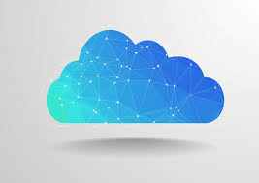

Scenario
The Department of Homeland Security has committed to 12 cloud service offerings, including nine private cloud offerings and three public cloud offerings, as part of its commitment to the White House's "Cloud First" policy. By moving its disparate dev and test systems into a private cloud, DHS anticipates being able to greatly accelerate the delivery of new software and services. Server provisioning time should decrease from six weeks to a day, and the service will include on-demand testing and app management. Your team is asked to submit a tech proposal to the department of homeland security for this cloud implementation project. Your submission should specifically respond to the context referred in this prompt.

Slide 3

What is Cloud Computing?
Cloud Computing is the delivery of different services through the internet
Services include data storage, servers, databases, networking and software
Files are stored in cloud-based storage in a remote database that can be accessed as long as devices are connected to the internet
This allows access to data and software remotely from many locations as long as they are connected
Services can either be hosted publicly or privately to specific clients on a given network

Slide 4
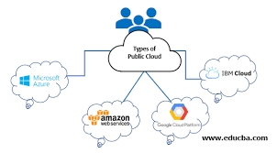
Public clouds
A public cloud is a type of cloud that has third party services make computing services. Third party service can have ready to use software applications or virtual machines.
Examples of public clouds: AWS, IBM, Google, Microsoft, Oracle and Salesforce
It is made so users can connect over a public Internet connection
Types of public clouds
Infrastructure as a service : Cloud providers builds the cloud by giving features like servers, storage and virtualized systems.
Platform as a service:the cloud provider offers hardware and software so clients can develop their own applications
Software as a service: Cloud provider host applications and provides that application to their clients.
Purpose of public clouds: It is used to give the ability to anyone in a company can arun their workloads on a cloud platform.

Slide 5
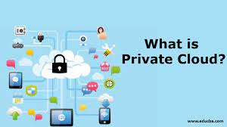
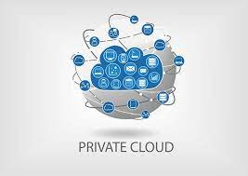
Private Clouds
Private clouds are single tenant environments ,which means that there is only one organization and they control it
Private networks can be hosted third party resources or it be already on the premises
Private cloud provides the benefit of being able to customize a cloud that suits you and have control over it. It also offers great amount of protection,
Different types of private clouds:
On premises private cloud- clouds owned by the organization and is run on site.
Managed private cloud- third party vendors monitors the cloud but it is owned by the organization
Virtual private clouds- clouds that offer access to a public cloud resources but can privately connect through virtual private networks

Slide 6
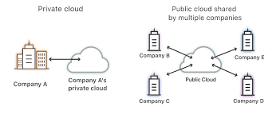

Slide 7
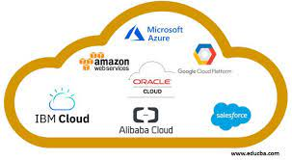
Public Cloud Offerings
Amazon Web Services (AWS)
The biggest in the industry claiming ~48% on recent Gartner reports of the cloud based infrastructure market. Amazon's public cloud offering allows for scaling when needed and also the ability to reduce capacity to save on some costs.They also provide many tools included with the amazon ecosystem that can assist with cloud management tools, internet of things, machine learning and more.
Microsoft Azure
Open source platform that has many software services for cloud based operation needs. Microsoft has a large group of partnered companies and developers that allows for many cloud based infrastructures to thrive. According to Gartner reports microsoft has a 15% market share
Google Cloud Platform
While google cloud is huge with consumers for businesses they tend to aim for smaller to medium sized businesses, accounting for roughly 4% of the market share Google Cloud has an all in one type of packages for businesses to make use of.

Slide 8
Cloud Based Development Solutions
Application Development Solutions
Application Testing Solutions
GitHub
Allows for multiple people to work on the same project with version control using git repositories
Docker
Allows for publication and configuration of applications using OS virtualization allowing for fast, portable and easy app development.
Akamai CloudTest
Allows for cloud based stress testing environments to ensure desired results are met under load
Nessus - Vulnerability Testing
Allows for cloud based vulnerability testing, the service allows for modernization of security for applications as well as checking for latest common vulnerability attacks.

Slide 9
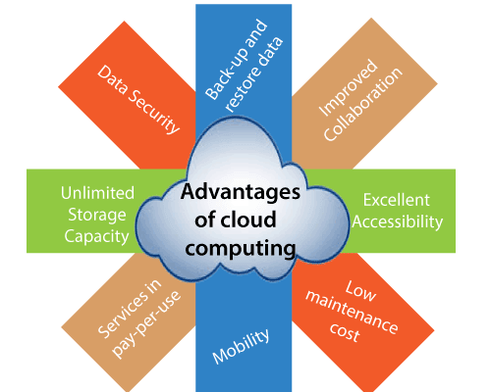
Advantages of Cloud Computing
Cost Efficient
Servers and the cost of setting them up can be very expensive.
Organizations and companies that use cloud computing save more than 35% on operating expenses each year according to the Global Cloud Services market
Unlimited Storage Capacity
The capacity can be increased when needed. Whereas in a server you would have to buy new hardware and software
It is much easier to back up and recover data
Speed
Data can be backed up much quicker compared to disc consolidation
Data control
It collects data for the company from every user and office to a single location. The data can be controlled without having to travel to a different location.
Environmentally friendly
The use of cloud computing reduces carbon emissions.
Helps save on energy

Slide 10
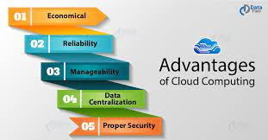
Advantages of Cloud Computing Continued
Reliability
Cloud services have redundant infrastructures, which makes them reliable. They also have several IT services.
Flexibility
You can work or access data anywhere as long as there is internet connection.
Helps save space
Servers take up an excessive amount of space and are usually stored in their own separate room

Slide 11
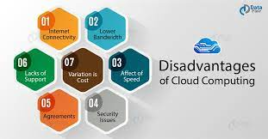
Disadvantages of Cloud Computing
Technical issues
A malfunction can occur at any moment. A strong internet connection is always needed in order to access the server. (If the network goes down, access to the cloud is unreachable)
No Control
Cloud services restrict access to most components of the system. This also makes it difficult for a company to switch over to another cloud system because they have limited access to some of their data.
Users have limited access to the backend of the cloud service, which is a security risk. There could be accidental data exposure since they don’t have control over it.
Security risks
Users have limited control over most things. If there were a data breach or data leak there is a possibility that they never find out.

Slide 12
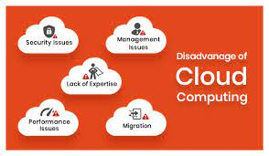
Disadvantages of Cloud Computing Continued
DOS attacks
Denial of service attacks
Cloud service users have no control or say of anything if there is a DOS attack
Bandwidth Limitations
Certain Services have bandwidth limitations.
Different cloud services have set bandwidths. However, if a company goes over the set bandwidth they will get charged. The charges can start to add up which can make cloud services expensive.
There are cloud services that do have unlimited bandwidth.
Compliance
Not all companies can use a public cloud. For example, healthcare companies, financial services, and some businesses are not able to use public clouds due to the sensitive data they store.

Slide 13
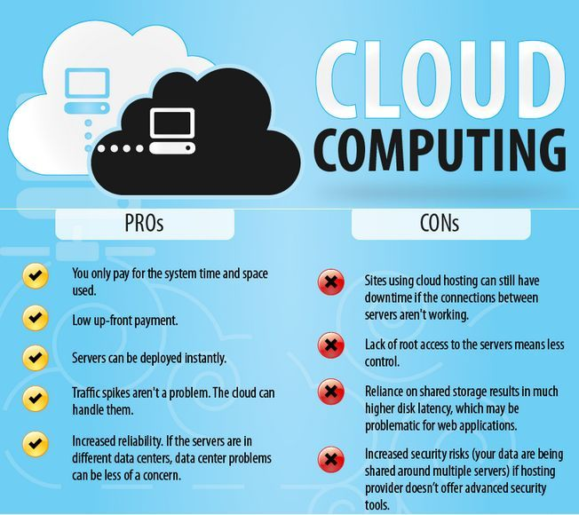

Slide 14
Challenges of Migrating to Cloud Services
Financial Cost
Rewriting application architecture for the cloud
Investing in tools to migrate successfully
Latency, Downtime and Bandwidth costs
Adoption Resistance
Employees can be resistant to change
Systems and processes will be significantly changed
Disruptions can occur during and after the migration process
Lack of Skill Among Employees
Employees will need to be retrained
There may be a need to higher cloud experts
Skill shortage of cloud experts

Slide 15
How Should We Implement Cloud Services?
We should make use of a change management plan that has three core tenants
Cloud services should be adopted in batches
Breaks cloud adoption into separate phases
Only certain areas will experience downtime instead of all services
Helps better manage disruptions
Get leadership top buy-in and choose intuitive tech solutions
Communicate objectives to executives so that the rest of the organization can understand reasons for change
Choosing user-friendly tech that already integrates with existing systems
More likely to get other employees behind the change
Invest in expert training and resources
Hire cloud experts to help with migration and train employees
If experts are in short supply make use of cloud resources
This will cultivate cloud expertise among existing employees

Slide 16
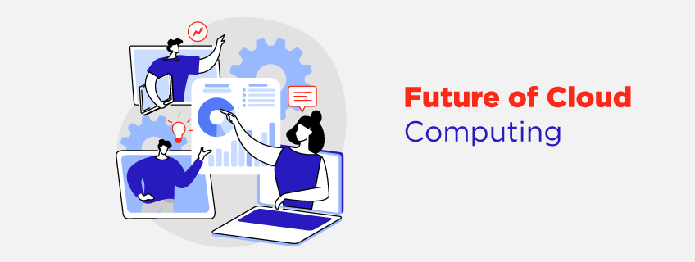

Slide 17
Future of Cloud Computing
One future aspect of cloud computing is changing the demand of cooling needs at data centers
The U.S. government estimated that data centers in the country used around 70 billion kWh of electricity in 2014, which equates to about 1.8% of the country’s total consumption
Companies like Intel and Microsoft are planning to become net positive for water use by the 2030
Fact: It estimated that data centers use 660 billion liters of water in 2020, which is 264,000 olympic sized swimming pools
We recommend in the future that we follow the lead of Microsoft and Intel try to reduce our water usage. One suggestion is that we can replace using water to cool with outside air

Slide 18
Sources
https://www.accenture.com/us-en/cloud/insights/cloud-computing-index?c=acn_glb_brandexpressiongoogle_12720343&n=psgs_1221&gclid=CjwKCAiAjs2bBhACEiwALTBWZVdBd8MVLi7ccF89riexHzr7o7Cv-M5VvzhpVYLlri5GrgV6QR_bxxoCvSAQAvD_BwE&gclsrc=aw.ds
https://www.techtarget.com/searchitchannel/definition/cloud-provisioning
https://www.techrepublic.com/article/multicloud-the-smart-persons-guide/
https://www.techrepublic.com/article/private-cloud/
https://www.techrepublic.com/article/what-are-public-clouds/
https://dataconomy.com/2022/05/pros-and-cons-of-cloud-computing-2022/
https://www.lucidchart.com/blog/challenges-with-moving-to-the-cloud
https://www.investopedia.com/terms/c/cloud-computing.asp
https://www.theregister.com/2022/11/30/aws_powers_earth_observation_satellite/
https://www.cnbc.com/2020/10/13/water-has-become-a-big-issue-for-big-tech-but-microsoft-has-a-plan.html
https://appinventiv.com/blog/cloud-application-development/
https://www.frameworkit.com/blog/best-public-cloud-vendors

